Slide 1

IT 334 – DevOps Engineering on AWS Cloud
Project – Building a Highly Available, Scalable Web Application
Group X: Ejub Šabić
Kerim Ahmedspahić Amar Fazlić
Date:
11. June 2023
Teacher: Dzenana Dzevlan

Slide 2
Business scenario overview
XYZ university has experienced significant growth since last school year, resulting in a large increase in student applications this semester.
However, this growth has presented a challenge: our university's web application is not equipped to handle the additional traffic.
Our task was to provide a cost-effective, highly available, and scalable web application that can handle a large number of requests without compromising the user experience.
Solution Requirements:
Always available
Able to scale without affecting user experience
Sends all content to the university Database
Notes:
You can also go more in depth about the design considerations and trade-offs that you made.

Slide 3
Solution overview
AWS Infrastructure for University Web Application
We‘ve remade the architecture from the Phase 1 of the project to make it support the high demand.
We‘ve chosen to use ASG provided by AWS in combination with RDS, to save money while having secure, reliable, and always availiable application, that can keep up with thousands of simultaneus requests.
We‘ve used multiple AZs and Load Balancer to ensure high availiabilty throughout different regions.
Also RDS made all database management much easier, and provided us with automatic backup which furthermore improves our application.
Above mentioned implementations allowed users to perform all CRUD operations, without a worry of some their requests not going through, even in the peek usage time which for this application is probably working days(Monday-Friday) and working time of the XYZ University (09:00-17:00)
Notes:
Explain at a high level what you have built.
For example: “I built a web application for a company to host their blog.“
Talk about why you chose certain parts of the solutions and any tradeoffs that you made. Focus on how you designed the solutions and how you applied the AWS Well-Architected Framework as part of the process (AWS Well-Architected Framework: https://docs.aws.amazon.com/wellarchitected/latest/framework/welcome.html).
For example: “I configured load balancers and auto scaling to make the application highly available and reliable.”
Include the use cases that you are addressing. Think about who your users are and how they would want to interact with your solution to solve their problem.
For example: “Users can view, upload, edit, and delete blog posts. Administrators can approve blog posts.”
Talk about the use cases that you addressed as part of the minimum viable product (MVP) that you scoped and built.
Note:
An above-bar description is concise and includes the most important benefits. For example: “The solution allows customers to quickly upload, store, and search large catalogs of images and videos in Amazon S3.”
A below-bar description is too detailed or not specific. For example: “Our solution analyzes media files.”

Slide 4
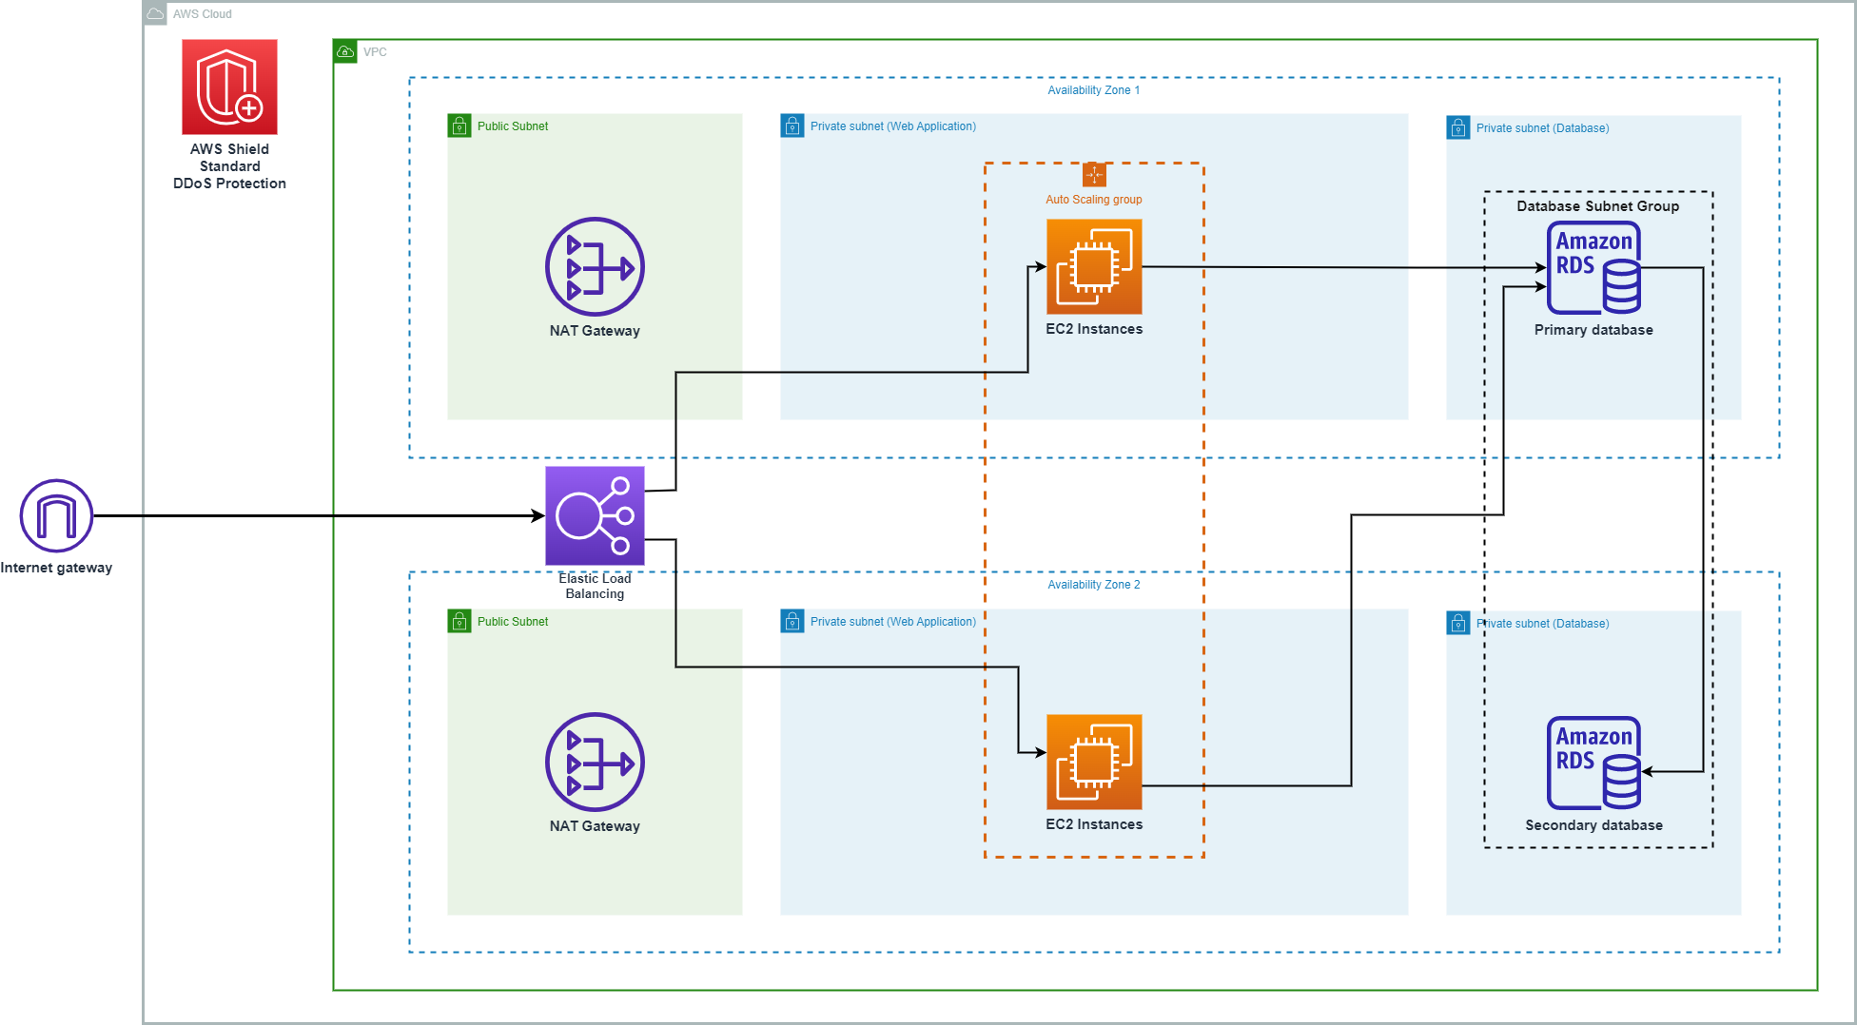
Architecture diagram of the planned solution
Reference: https://docs.aws.amazon.com/whitepapers/latest/web-application-hosting-best-practices/an-aws-cloud-architecture-for-web-hosting.html

Slide 5
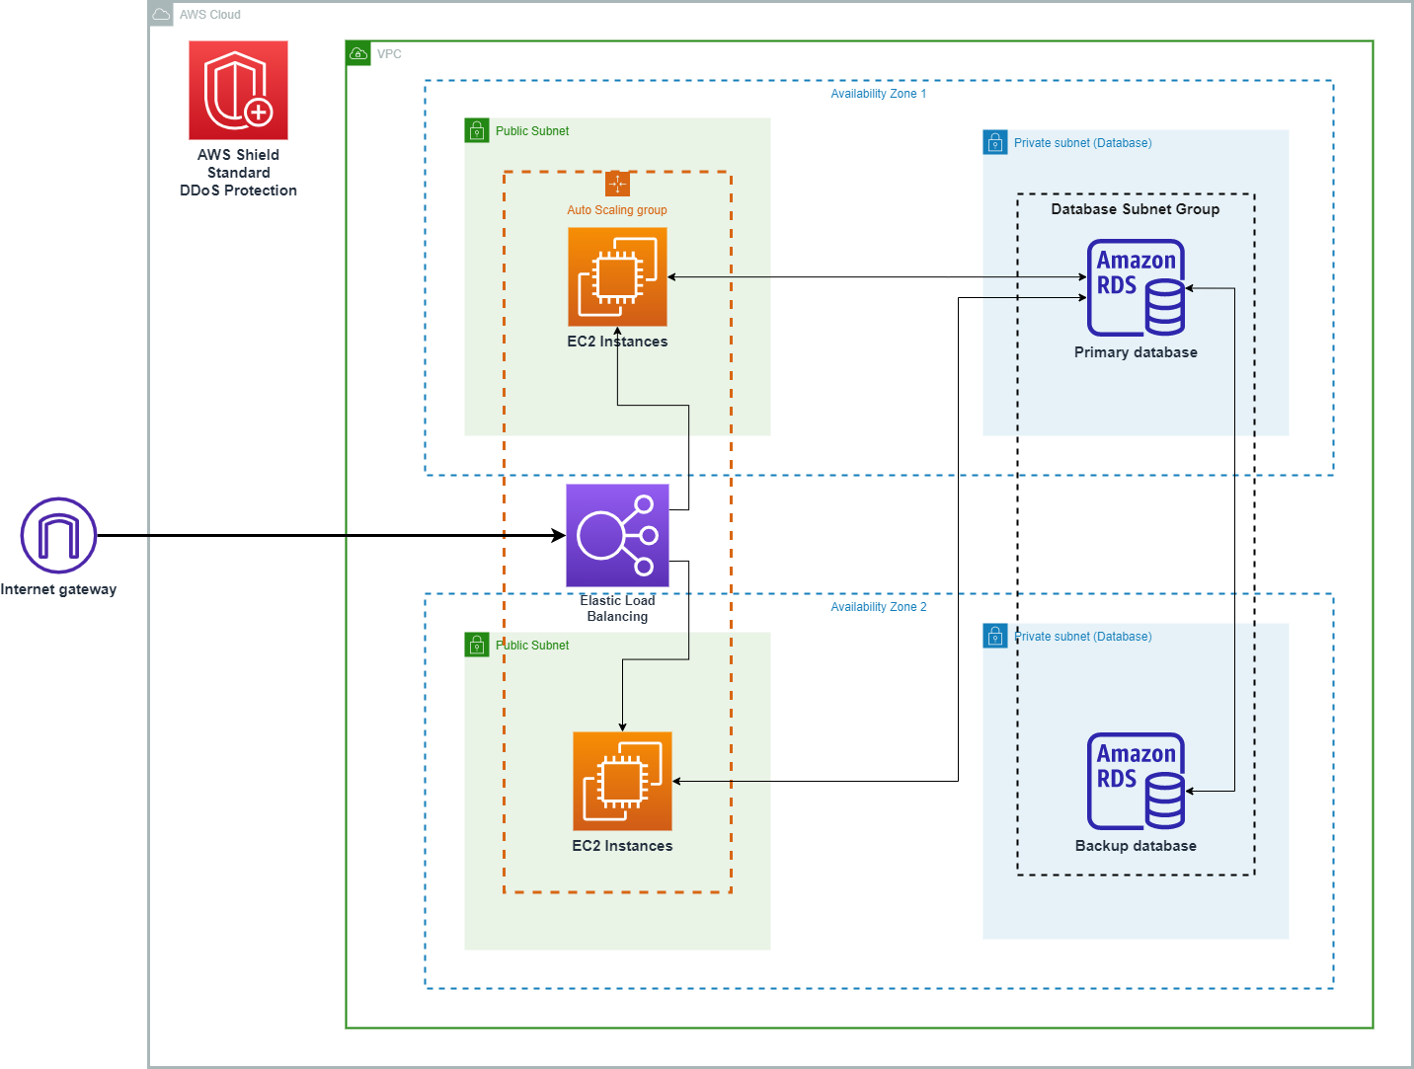
Architecture diagram of the final solution

Slide 6
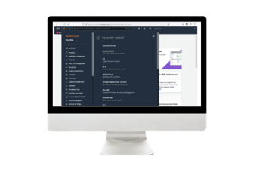
Demo
http://alb-group12-1087131232.us-east-1.elb.amazonaws.com/students
Notes:
For the demo, guide the audience through the two to three most important benefits of the solution and how it addresses the requirements.
Your demo materials can be screen captures, recordings, or to show AWS console.

Slide 7
Lessons learned
Challanges
We weren't sure which IAM role to use at first, but we figured it out right away.
We weren't sure which OS to use when creating EC2 instances.
The database migration was difficult, and we initially encountered a lot of errors. However, we quickly discovered the solutions.
Inbound rules posed a challenge because we were not sure how to set up EC2 instances to be publicly available when they were created automatically.
Notes:
Describe any challenges that you encountered and how you overcame those challenges.
For example: “I got stuck when I was creating an EC2 instance to host the application. I used the resources that were listed in the instructions to walk myself through the process to create a new EC2, and I was able to complete the task. The links to labs in other courses were very helpful.”
Describe any new skills that you learned from this project.
For example: “I learned how to set up auto scaling correctly so my resources were automatically adjusted and allocated at the lowest possible cost.”
Discuss any future, out-of-scope use cases in the next steps.
For example: “I would like to scale out the web application so that multiple departments can use it.”

Slide 8
Lessons learned
Challanges
Tedious documentation: We've had problems concentrating on creation of many .md and .pptx files just like this one. None of us likes writing documentation and we easily get bored from it, thus most of the times we ended up watching random YouTube Videos. But we happily overcame this issue when pressure struck 2 hours before the deadline.
Security groups issues: In the beginning we had troubles understanding security groups, inbound and outbound rules, thus we could not complete Phase #3, but happily in the end, aforementioned YouTube came to the rescue and we've completed everything like it's said in Bosnia "Prvi put' iz treće...".
All these are explaing in more details on our GitHub on Readme.md
Notes:
Describe any challenges that you encountered and how you overcame those challenges.
For example: “I got stuck when I was creating an EC2 instance to host the application. I used the resources that were listed in the instructions to walk myself through the process to create a new EC2, and I was able to complete the task. The links to labs in other courses were very helpful.”
Describe any new skills that you learned from this project.
For example: “I learned how to set up auto scaling correctly so my resources were automatically adjusted and allocated at the lowest possible cost.”
Discuss any future, out-of-scope use cases in the next steps.
For example: “I would like to scale out the web application so that multiple departments can use it.”

Slide 9
Lessons learned
Acquired skills
Mastered the use of most popular AWS Services
How to use AWS Services to deploy a Web Application
How to use AWS Pricing Calculator
Future steps:
Create database backups and further scale the application in the event that our university experiences significant growth.
Notes:
Describe any challenges that you encountered and how you overcame those challenges.
For example: “I got stuck when I was creating an EC2 instance to host the application. I used the resources that were listed in the instructions to walk myself through the process to create a new EC2, and I was able to complete the task. The links to labs in other courses were very helpful.”
Describe any new skills that you learned from this project.
For example: “I learned how to set up auto scaling correctly so my resources were automatically adjusted and allocated at the lowest possible cost.”
Discuss any future, out-of-scope use cases in the next steps.
For example: “I would like to scale out the web application so that multiple departments can use it.”

Slide 10

Demo
Notes:
Describe any challenges that you encountered and how you overcame those challenges.
For example: “I got stuck when I was creating an EC2 instance to host the application. I used the resources that were listed in the instructions to walk myself through the process to create a new EC2, and I was able to complete the task. The links to labs in other courses were very helpful.”
Describe any new skills that you learned from this project.
For example: “I learned how to set up auto scaling correctly so my resources were automatically adjusted and allocated at the lowest possible cost.”
Discuss any future, out-of-scope use cases in the next steps.
For example: “I would like to scale out the web application so that multiple departments can use it.”

Slide 11

Questions?

Slide 12
THANK YOU!

